Slide 1
Photo Classification using CIFAR
Suresh Danala
Rushabh Barbhaya
Satvika Shetty
Sakshi Nevatia
Siddhant Burande

Slide 2
Introduction
Deep learning can categorize things as well as or better than humans when given a high-quality set of data. People may be able to dedicate more time to more enjoyable pursuits by automating some of the more repetitive chores if a highly accurate picture classifier is developed. This research project will use a unique CNN structure to categorize pictures from the CIFAR-10 dataset. To improve classification rate and accuracy, a two-dimensional convolution layer was utilized in lieu of the original model's max-pooling and dense function.

Slide 3
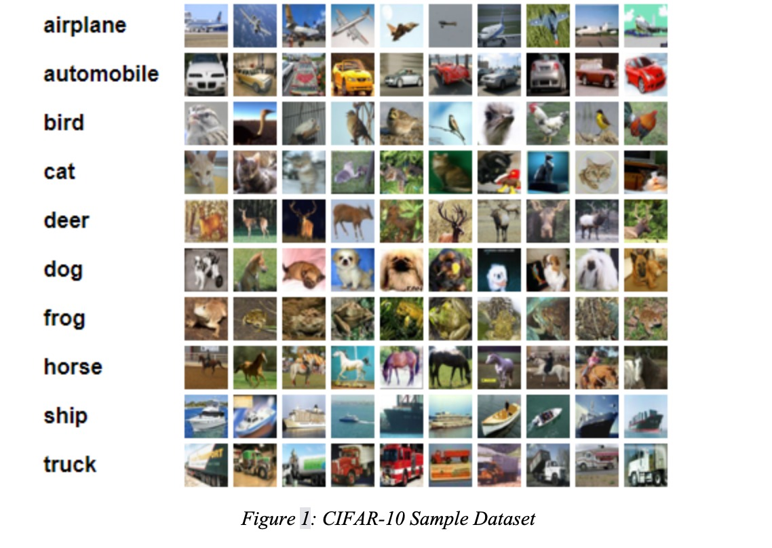
Data Set: CIFAR-10
Data Set :CIFAR-10 is photo classification dataset used for image classification. The data set consists of 60,000 32*32 color images that are divided into 10 classes, with 6000 images per class. The data set consists of 50,000 training images and 10,000 test images. It will be divided into 5 training batches and one test batch for each 10,000 images.

Slide 4
Related Work:
An auto-encoder is a form of unsupervised artificial neural network that learns efficient data coding. An autoencoder's goal is to train the network to ignore signal "noise" to learn a representation (encoding) for a set of data, generally for dimensionality reduction.
Fraud Detection
Anomaly Detection
Denoising

Slide 5
Method
This application is to exercise one of the machine learning models' applications to re-create and remove the noise from the images. The dataset doesn't contain any noise on the image. The noise is added to the images using simple functions. The goal is to get the original image back after adding the noise to the pictures. The training set uses 50,000 photographs, and 10,000 images are used for testing. The actual size of this image is 32 x 32.
Four models were created to test different functionalities from the machine learning models. The first model used two convolutional dimension layers of 32 and 64 units with Batch Normalizer and Max Pooling. An Adam optimizer with a learning rate of 1/10,000.

Slide 6
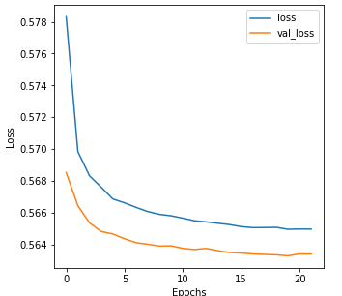
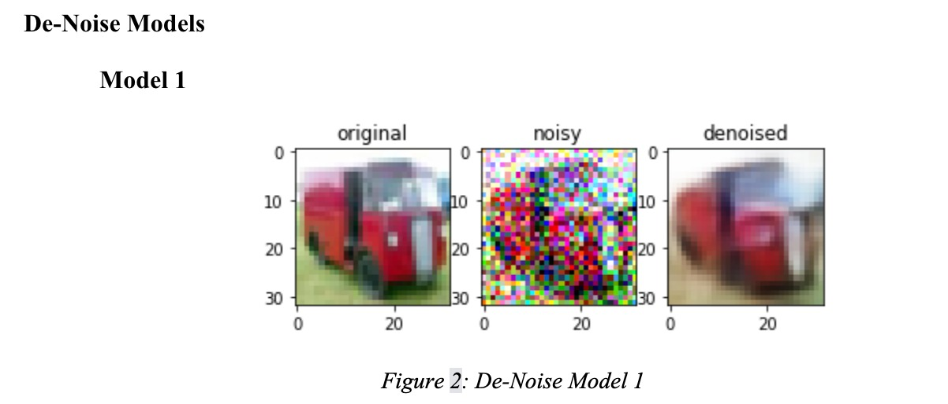
Method (De-Noise Models)
Two approaches were used:
De-noising Model
Object Recognition
Value Loss: 0.56; Value Accuracy: 72.1%

Slide 7
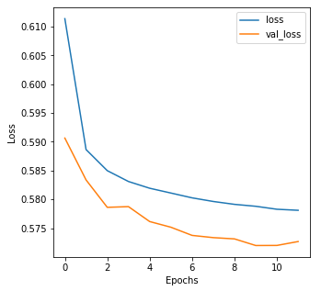
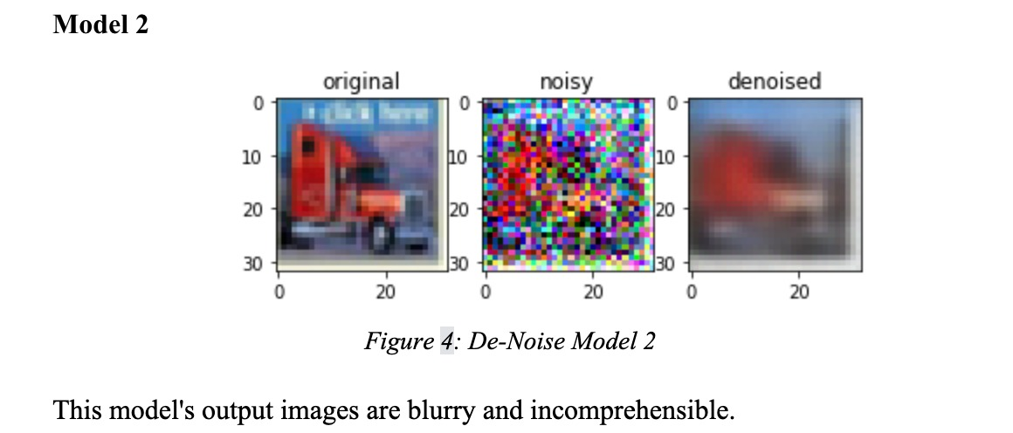
Method (De-Noise Models)
Two approaches were used:
De-noising Model
Object Recognition
Value Loss: 0.57; Value Accuracy: 69.3%

Slide 8
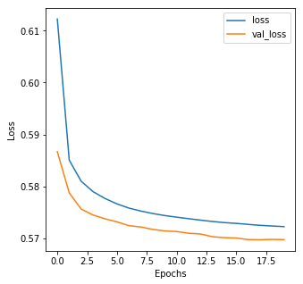
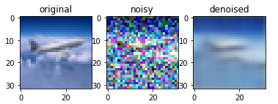
Method (De-Noise Models)
Two approaches were used:
De-noising Model
Object Recognition
Model 3
Value Loss: 0.56; Value Accuracy: 65.49%

Slide 9
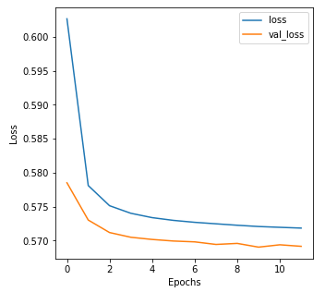
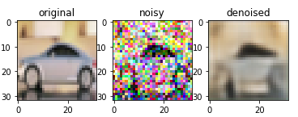
Method (De-Noise Models)
Two approaches were used:
De-noising Model
Object Recognition
Model 4
Value Loss: 0.57; Value Accuracy: 64.5%

Slide 10
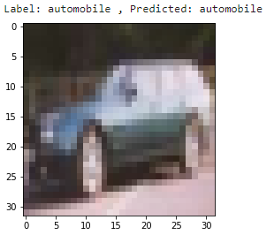
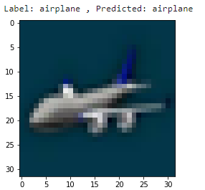
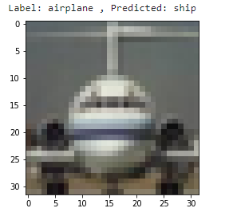
Method (Object Recognition)
Two approaches were used:
De-noising Model
Object Recognition
Value Loss: 1.21; Value Accuracy: 77.31%

Slide 11
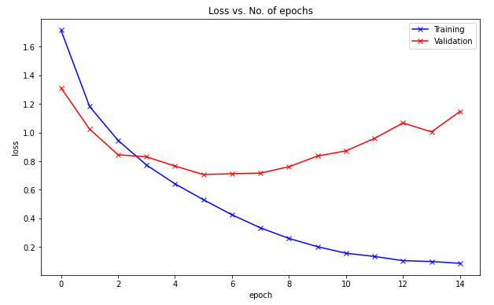
Method (Object Recognition)
Two approaches were used:
De-noising Model
Object Recognition

Slide 12
Result
Data from the (CIFAR-10) was used to build an Artificial Neural Network (ANN) algorithm. The modified model attained an 88 percent classification accuracy rate after 10 hours of operation

Slide 13
Conclusion
According to the findings of this study, it is possible to improve the accuracy of CNN models by using computer language that is easily executed and modified. When comparing accuracy and runtime, it is worth noting that this model required more computing power to achieve its highest accuracy, but when it came to running time/accuracy, it won with the most common CNN structure. AI developers would have to decide whether the more powerful models are worth the extra effort based on the available components.

